Slide 1
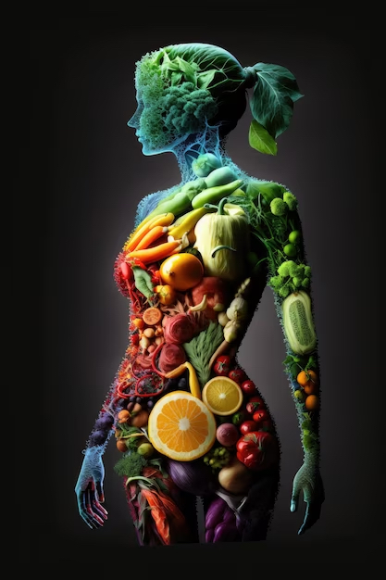
ArtisanAl Recipe Generator
Athanasios Chryssis
Yee Wai Haung (Vivian)
Jovane Cano
Cody Cheatham
Theint Zin Tun (Sophia)

Slide 2
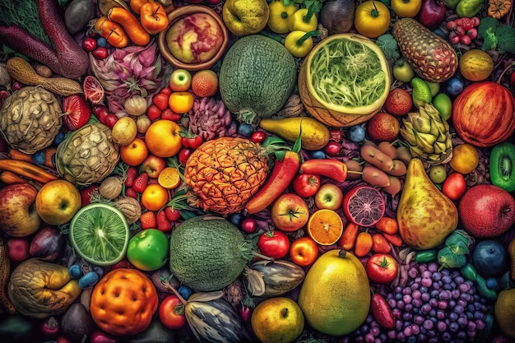
Struggling to decide what to cook? Our goal is to assist indecisive cooks like you with our recipe generator! whatever you choose, you’re sure to find a nutritious and delicious recipe to satisfy your cravings and fuel your body. Now, let's dive into how we crafted this culinary marvel!

Slide 3
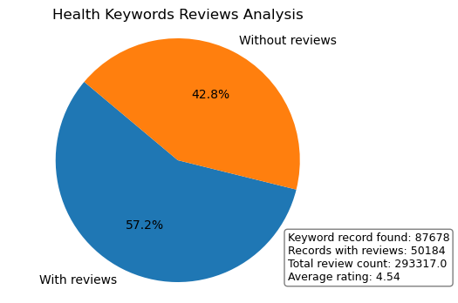
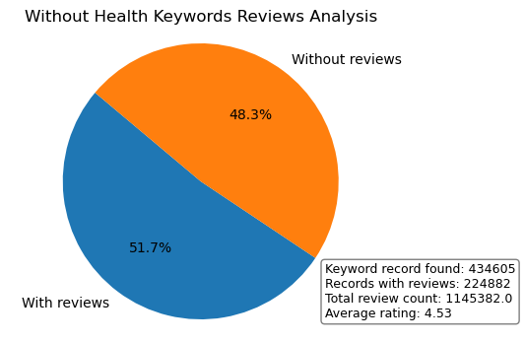
Recipes containing health-related keywords in their search descriptions receive 5.5% more reviews.

Slide 4
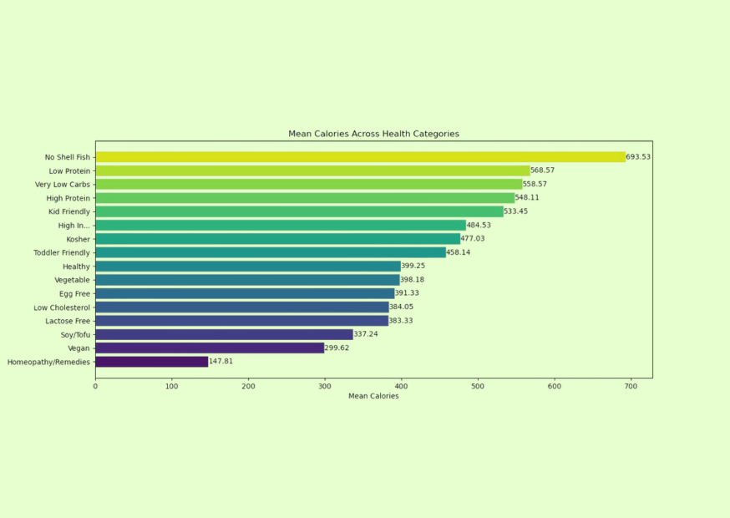
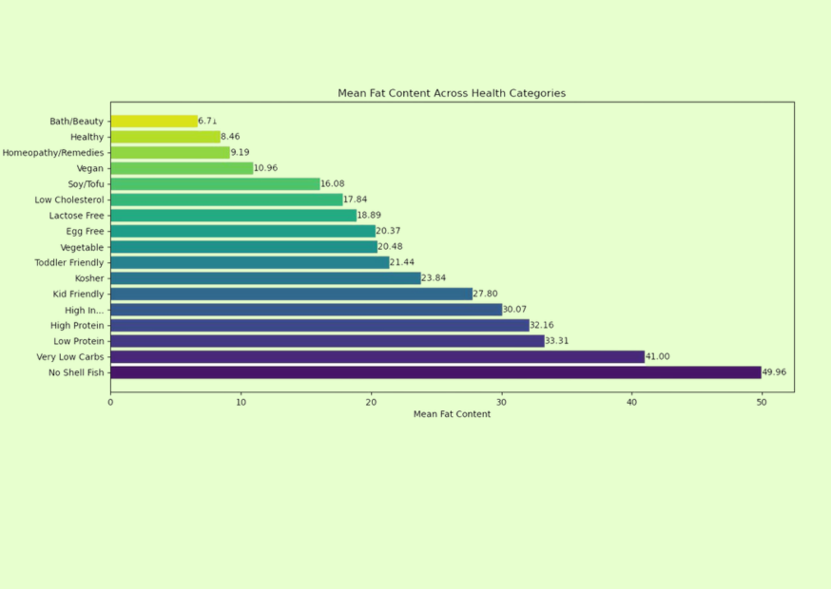
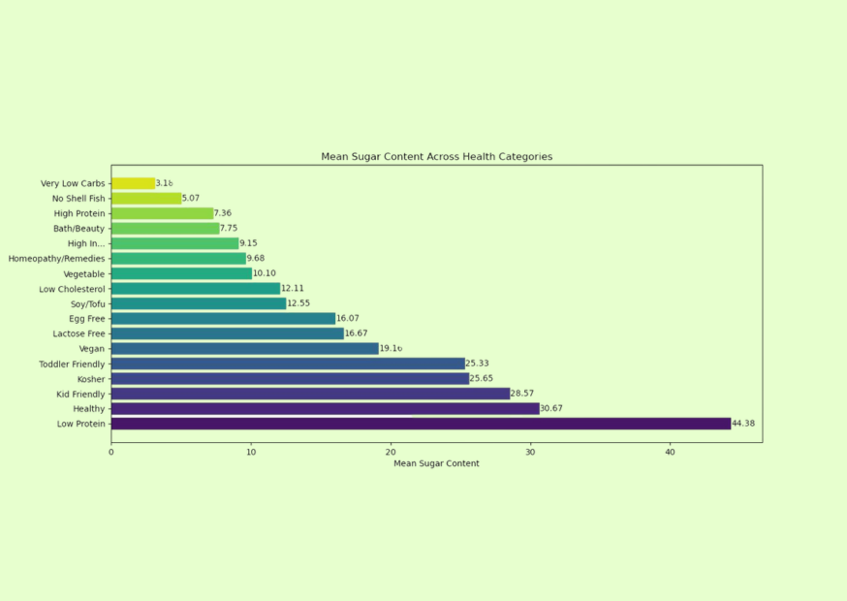
Dietary Analysis
🥬 Findings:
For average calories and fat content, the category “No Shell Fish” had the highest value.
🥦 Findings:
For average sugar content, the category “Low Protein” had the highest value.

Slide 5
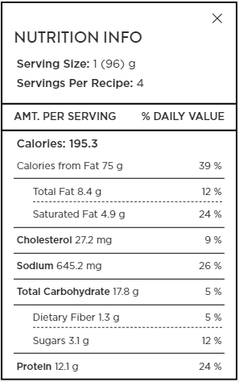
Strategy
Apply Category Thresholds:
Low Protein: Low-protein diet restricts intake to 0.6 to 0.8 grams of protein per kilogram of body weight daily.
Low Cholesterol: Cholesterol intake to under 200 milligrams per day, achieved by reducing fatty meats, full-fat dairy, and processed foods.
High Protein: Protein intake, recommends 1.2 to 2.2 grams per kilogram of body weight daily.
Low Sodium: "low-sodium" or "reduced-sodium" typically containing 140 milligrams or less of sodium per serving.
Low Carbs: Carbohydrate intake on a low-carb diet are restricted to 20 to 150 grams per day.
High Fiber: High-fiber diet aiming for 25 to 30 grams of fiber daily.
🧇
🍆
🥩
🍇
🥑
🥝

Slide 6
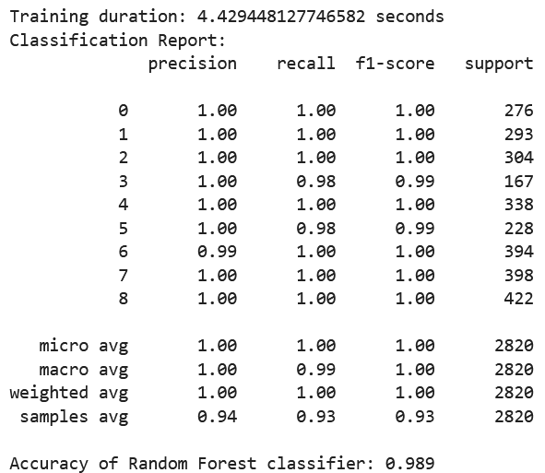
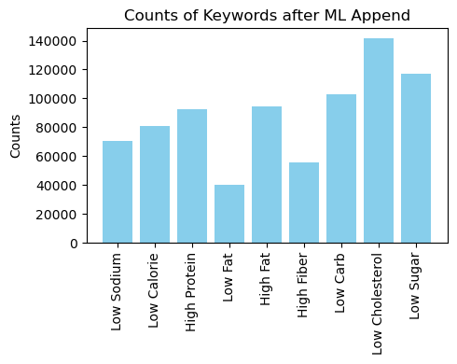
ML training from Category Thresholds
ML model training
Generate a small sample dataset with predefined category thresholds for model training, utilizing GridSearchCV with Random Forest Classifier to identify the optimal model configuration
Apply model to dataset
Apply ML generated best model on complete dataset to integrate relevant health-related keywords into the Keywords field.

Slide 7
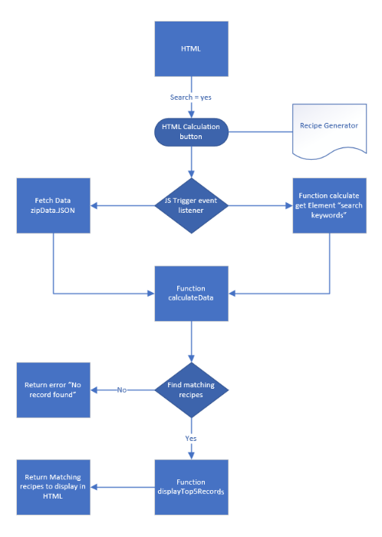
Front end design
HTML search interface:
Design a user-friendly front-end interface featuring a dropdown menu for user searches, facilitating the exploration of delectable and nourishing recipes tailored to individual dietary preferences and wellness objectives.
JavaScript backend:
Utilize JavaScript to process user selections, triggering the identification of matching recipes and presenting the top five suggestions based on the chosen criteria.

Slide 8
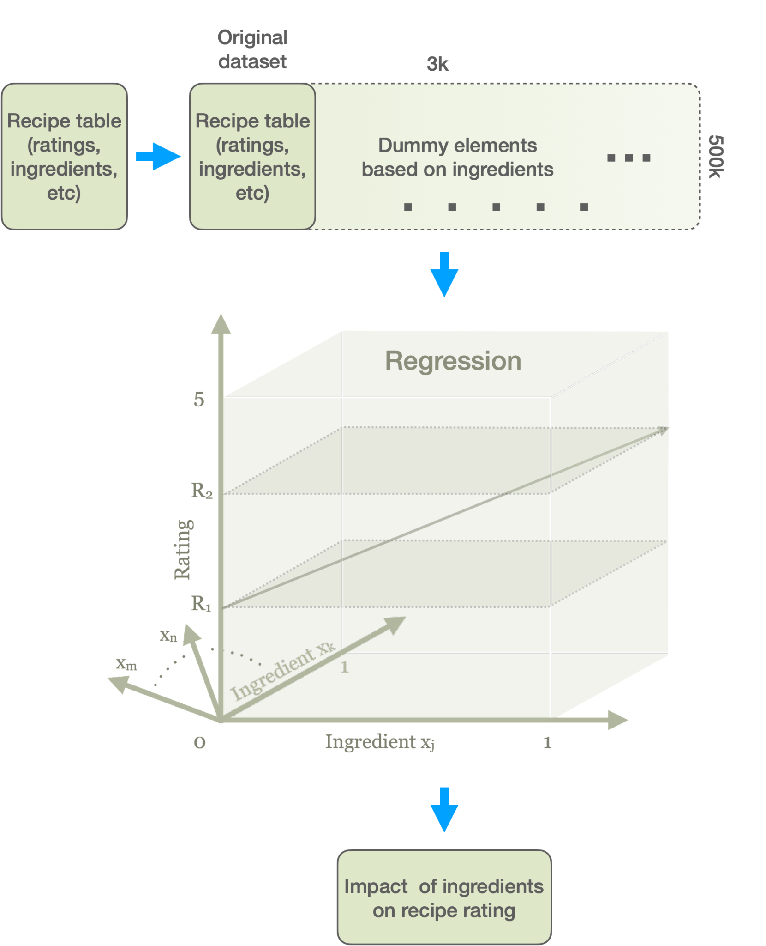
Algorithm description
Dataset: Data includes recipe ingredients, instructions, nutritional facts and recipe ratings on over 500k recipes
Create Dummy table on all ingredients: Matching ingredients and creating a large dummy dataset with over 3k columns
Row selection based on user input : reduce dataset based on dietary restrictions, cook time, cuisine and occasion
Regression: Fitting a model fitting every ingredient on the recipe rating. Features are binary but target is a continuous metric
Results: Our Model is able to produce the top ingredients that mostly impact the popularity of the food and use that as a guide for recipe improvement and pairing
Future Work:
Extend user input, (eg. available ingredients)
Extend database for pairing selection (wine, desserts)

Slide 9
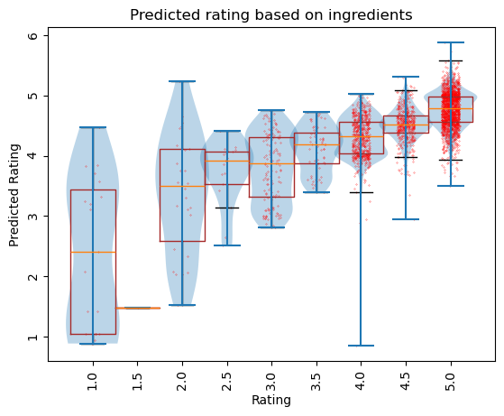
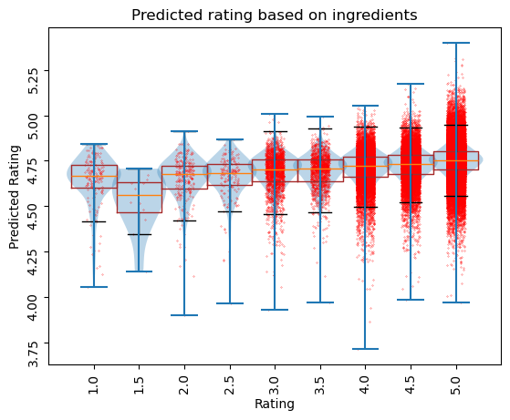
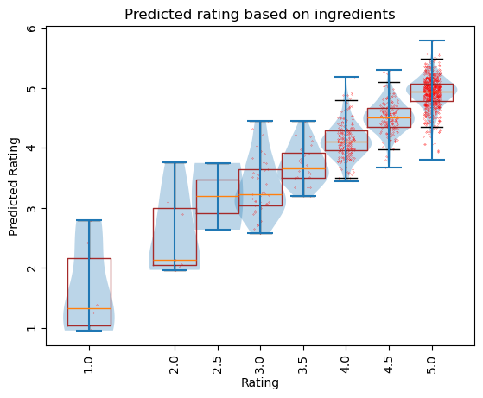
Algorithm results
Indian
Top Ingredients | Impact
tamarind paste | 0.572754
black cardamom | 0.470215
fresh lime juice | 0.467926
rose water | 0.448242
carrot | 0.396484
dried fenugreek leaves | 0.350845
heavy cream | 0.333008
channa dal | 0.308105
fresh green chile | 0.301758
coriander leaves | 0.301758
Use case: We calculated the top ingredients used in different cuisines around the world
Conclusions: The algorithm predicts very well the dish popularity based on ingredients, especially when targeting certain food groups with similar pallet (eg. Countries)
Performance: When looking at the complete dataset the correlation is not as good, but the ingredient prediction is meaningful.
Top Ingredients | Impact
chocolate ice cream | 0.210091
amarula cream | 0.178007
black tea | 0.163687
real butter | 0.152184
creole mustard | 0.141259
cranberry juice | 0.135535
lean bacon | 0.132211
raw sugar | 0.127359
berries | 0.124390
ham bone | 0.123473
Globally
Greek
Top Ingredients | Impact
brown sugar | 0.468557
baking powder | 0.411140
celery ribs | 0.352051
long-grain rice | 0.306511
white wine vinegar | 0.283554
mint | 0.257141
green bell pepper | 0.250061
cheese | 0.244141
thyme | 0.236816
lean ground lamb | 0.211304

Slide 10
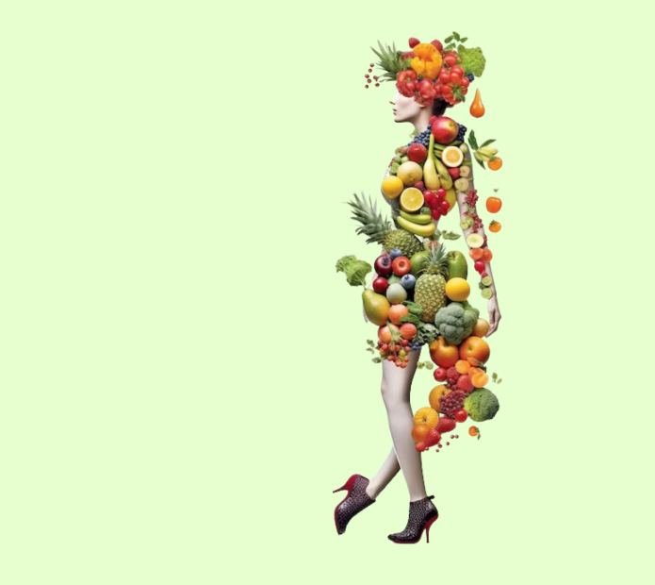
Recipe Generator Process
Step 1: Data Acquisition
We used a recipes and reviews dataset that can be publicly accessed on Kaggle. Food.com - Recipes and Reviews
Step 2: Data Cleaning
Preprocessed the dataset to remove duplicates, handle missing values, and standardize formats using Pandas other data analysis libraries in Python.
Step 3: Function Creation
Wrote Python functions to implement the core functionality of the recipe generators.
Step 4: Website Integration
Converted Python functions to Javascript for HTML integration then developed a website interface to interact with the recipe generators.

Slide 11
Presenting…
The ArtisanAl Recipe Generator

Slide 12
Future Direction
Expand our data - Increasing the number of recipes available within our database could help ensure all users find what they’re looking for within our website.
Add additional functionality to our website - Due to time constraints, we were not able to include all features we would have liked. Some additional functionalities we had in mind, include:
Advanced Search Filters: This would allow users to thoroughly describe what they are searching for and receive an appropriate recipe
Recipe Rating System: Allow users to rate the recipes and then have our website display another tab for our users’ favorite recipes.

Slide 13
Reference:
https://www.kaggle.com/datasets/irkaal/foodcom-recipes-and-reviews
https://www.cdss.ca.gov/agedblinddisabled/res/VPTC2/9%20Food%20Nutrition%20and%20Preparation/Types_of_Therapeutic_Diets.pdf
https://www.food.com

